Slide 1


Slide 2



Geographical Coffee Trade & Sustainability
(1990 – 2019)
Global Supply & Re-Exports
Where does coffee actually come from, and who makes the money?
Insights on importer countries
Is the money in drinking coffee or in moving it?
Coffee drinkers in Asia
Which country in Asia drinks more coffee than it can grow?
CO2 Impact
Is coffee cooking the planet?
Out of 180 coffee species, we mainly drink just two: Arabica and Robusta

Slide 3

Say Hello to our Baristas!
Kabilash
Kelvin*
Felix
Von
Originally 5 members, Team Hi^5 unanimously retained its name after Zhihong’s transition to Luckin Coffee.
*the OG Barista

Slide 4
Data Sources and Tools
Source | Data type | URL
 | Coffee economic indicators from the International Coffee Organization dataset | https://www.kaggle.com/datasets/michals22/coffee-dataset
 | List of countries with their ISO codes | https://www.kaggle.com/datasets/juanumusic/countries-iso-codes
Our World in Data | CO2 concentration in the atmosphere | https://ourworldindata.org/grapher/co2-long-term-concentration
Tool | Resources
ETL | PyCharm/ Python scripts, Postgres SQL, models including SQLAlchemy, Pandas, PyYaml
Visualization | Matplotlib, Seaborn, Plotly, Javascript, Alienart.io
Collaboration | GitHub, MS Teams, AI
“Java” became slang for coffee because coffee once shipped widely from the Indonesian island of Java.
Notes:
Data source:
Our data sources are primary from Kaggle and Url for co2 long term concentraion

Slide 5
Key Limitations
Tool | Resources
Datasets | Limited datasets; only pre-Covid data available from 1990 to 2019 Coffee types for import/exports are missing
Test-driven-development (TDD) | Due to time compression and lack of skillsets, we forgo this methodology and went straight to development. As such, we did not perform testing cycles during or post development. However, sanity checks on data quality are still done during ETL process
Code optimization | There is a point in time we need to stop coding and move on...with life Vectorize/flatten codes to reduce the use of loops Reduce repetitive file reads in functions
Our local kopi uses Robusta beans roasted in a hot wok with sugar and butter
Notes:
Additional notes
Datasets:
We only have coffee types for coffee production, but not for export/import and consumption.
We cannot increase the detail of our analysis by coffee types
Test-driven-development (TDD):
TDD is a modern methodology in software development
Advantages are few bugs and high test coverage amongst others
We did not perform any testing cycles during nor post development
Code optimiation:
Due to time pressure, there are many things we want to get done, one of it is code optimization
As loops carry heavy overhead for large datasets compared to vectors
Repetitive file reads penalizes I/O performance

Slide 6
Challenges & Takeaways
We have different types and levels of skill sets!
  All members have attempted coding ETL scripts and visualization​
  For some, 1st time handling PyCharm and GitHub
  Experienced members guide and explain the technical details along the way
  Leverage on skills for delegation of work
  Good to have diversity in the team, technical, visualization, artistic, project management.
Missing data due to economic changes (Belgium/Luxembourg):
  Use control ratio to backfill missing data from 1990 to 1998
Negative data in Brazil export data for 2014/2015/2019:
  Due to source corruption, had to patch from known source
Need to do sanity checks on datasets before loading
  No negative trade values (means no corrupted data)
  Missing country codes due to unresolved country names
Had to decide on whether it's better to create pivot tables into database during load or wrangle it using dataframes:
  More disadvantages than advantages
  Decided to manipulate the tables in a dataframes, when pivoting is needed.
Traditional Nanyang Coffee is brewed using a long-handled cotton filter bag that looks like a sock

Slide 7
Key Methodology & Approach
 | Centralized execution A main orchestrator script (main.py in Python) controls the pipeline by calling dedicated modules. |  | Modularity Isolated phases for extraction, transformation, and loading (ETL).
 | Configuration-driven: Pipeline parameters and dataset properties are stored externally. |  | Environment Isolation Sensitive credentials are secured via environment variables.
Arabica is a natural hybrid of Coffea canephora (Robusta) and Coffea eugenioides, native to Ethiopia and South Sudan.

Slide 8
Overview - Methodology & Approach
raw/
processed
extract.py
main.py
transform.py
.env
Analysis/
Visualization
GitHub
config.yaml
load.py
PostgreSQL
Coffee is the 2nd most traded commodity in the world, after crude oil

Slide 9
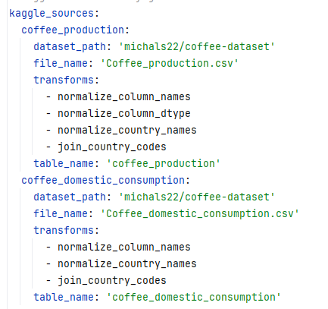
Extract-Transform-Load
Configuration files
config.yaml
Extract
    Dataset sources
    Transformation required
    Database table names
  Grabs all dataset sources​
  Save them as csv files into data/raw folder for further processing​
A latte is expresso with more steamed milk and a thin layer of microfoam

Slide 10
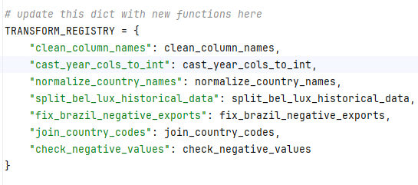
Extract-Transform-Load
Transform:
  TRANSFORM_REGISTRY, dictionary used to register each transform function
Transform functions
Clean/cast/update columns
Align country names to code
Backfill missing data for Belgium & Luxembourg from 1990-1998
Append country codes
Correct negative values in Brazil export
Load:
    Create tables in local PostgreSQL servers
    Options to load to online PostgreSQL like Neon
French press is an immersion brew that typically steep about 4 minutes

Slide 11
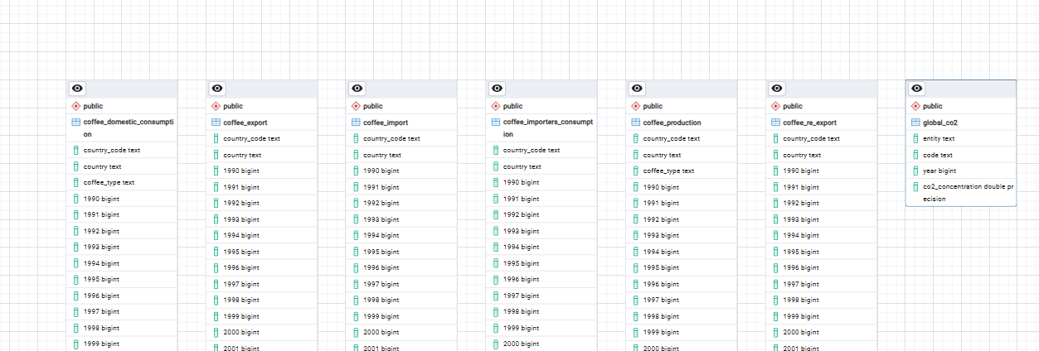
Database & Table Design
Load directly into local PostgreSQL to allow each member to perform analysis independently.
Country 3-alpha code added to coffee related datasets during transform phase to allow for easy joins, if needed.
No need to design relationship model or normalize tables; no schema used, schema is based on dataframe
Expresso shot times often fall around 25 – 35 seconds, but dependent on dose, grind and machine

Slide 12
On the World Map:
Countries who bring you Coffee

Slide 13
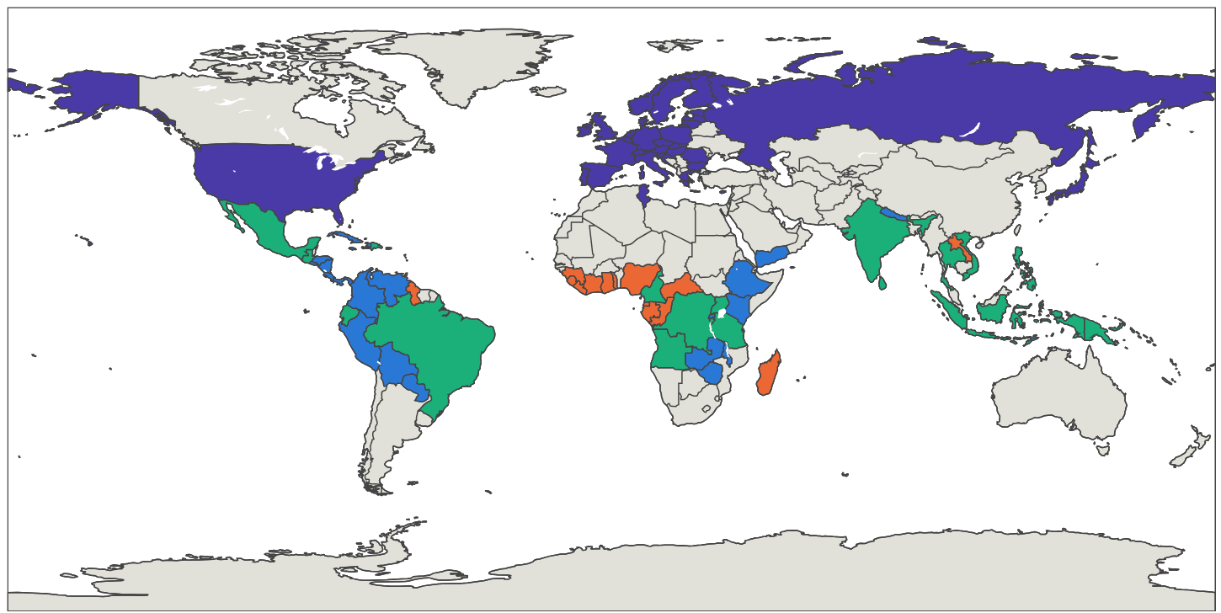
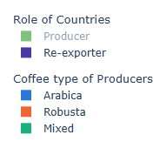
On the World Map
*This is an interactive HTML map

Slide 14
Insights on importer countries:
What is the consumption trend over time vs re-export volume?

Slide 15
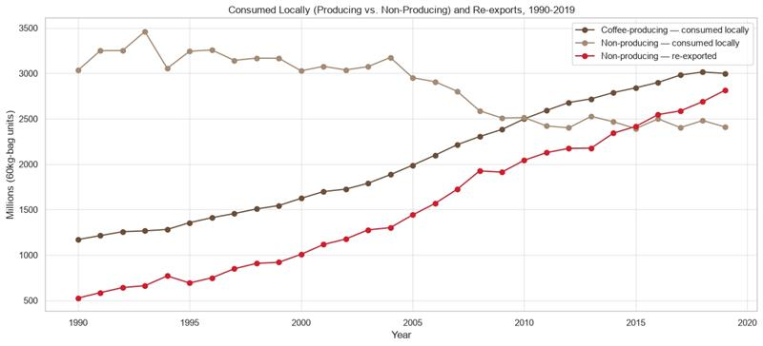
Coffee Importer Consumption Trends
Pre-heating cups help keep espresso temperature stable in the first sips

Slide 16
Coffee No Enough:
Which Asian country lim more kopi?

Slide 17
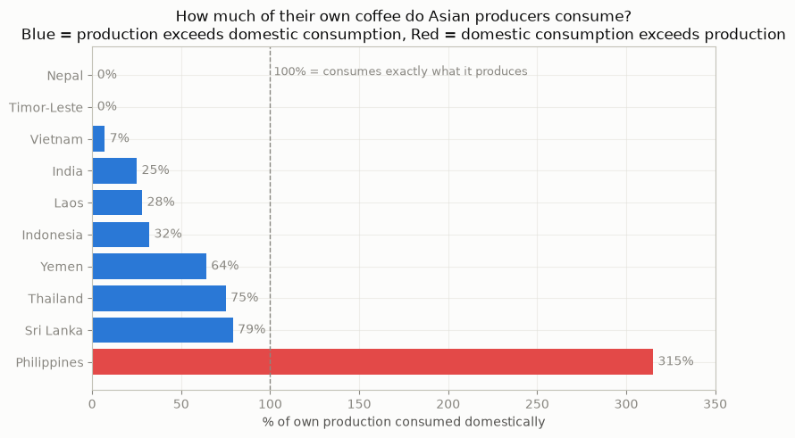
Coffee Production & Consumption in Asia
Philippines' demand is at a staggering 315% . They cannot grow enough to sustain their nation of coffee drinkers.
Almost 80% of Singaporeans consume coffee regularly, with 58% drinking it daily

Slide 18
Is Coffee cooking the planet?
Correlation != Causation

Slide 19
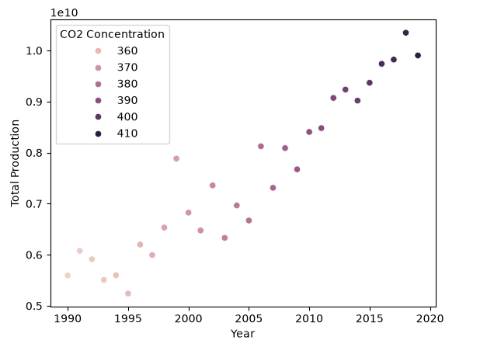

Correlation of CO2 & coffee production
Fun facts!
CO2: Greenhouses raise CO2 500-1,000 ppm to promote plant growth.
Water usage: Higher CO2 shrinks stomata openings in the leaves --> reducing water loss --> less water needed
How much CO2 is there in our atmosphere, in percentage, currently?
CO2 = 0.043 % as compared to oxygen at 20.95%

Slide 20
From Farm to Table:
Make a guess which are the
Top 15 coffee producing countries!

Slide 21
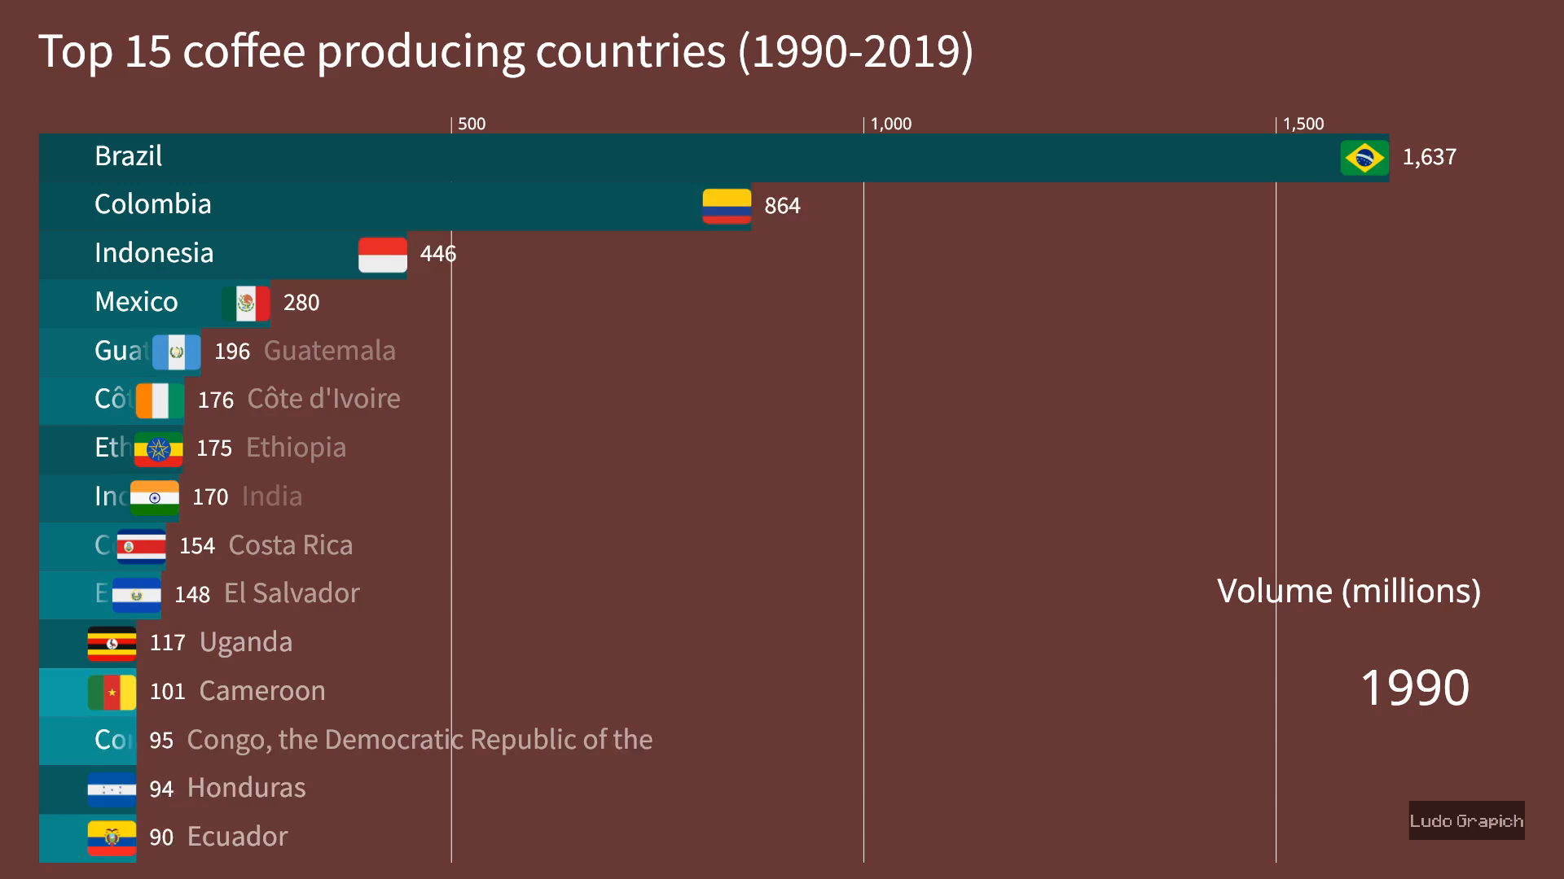
Source: https://alienart.io/projects/6a7fecbdea23d34093b7fe81

Slide 22
Conclusion
Open in the Philippines
315% of domestic production consumed. Demand already outrun supply
Buy, don't grow
55 producing countries.
34 re-exporters.
Zero overlap. The margin is booked in the middle.
Pour with a clear conscience – on this charge
CO2 and production rose together for 30 years.
Neither caused the other.
Total capital deployed: $0. Total capital raised: $0. ​ Consistency: Excellent.​
If time permits:​
Look in specialty coffee trade and consumption and perform predictive analysis on coffee trends
Do the same with tea leave trades, especially for matcha​
Coffee grounds are commonly reused in gardens and compost piles. Told you, we love Mother Earth!

Slide 23

THE END

